Slide 1













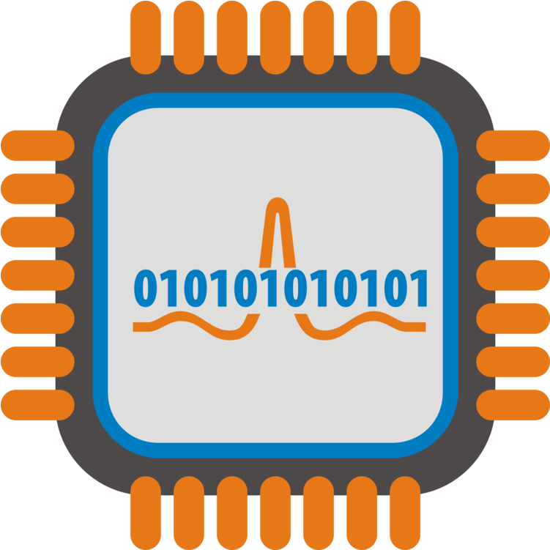


Generalizable Psychiatric Screening from Wearable:
Causal Disentanglement of Multi-channel Biosignals
with Interpretability Analysis
Wenting Kuang, Yufei Zhang, Yuqi Cheng, Kaishun Wu, Changhe Fan, Yongpan Zou
College of Computer Science and Software Engineering
Shenzhen University

Slide 2












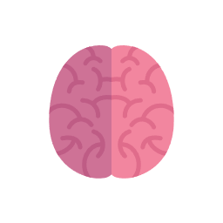









01
Introduction
The Key Elements of Emotion
Wearable Biosignals Analysis
Subjective Experience
Physiological Arousal
Behavioral Response
Scalable
Ubiquitous
Continuous
Objective
Source: Verywell/Emily Roberts

Slide 3
Introduction
Challenge
Individual variability introduces a domain gap that hinders model generalization.
Limited explainability constrains the clinical application of models.
Contribution
Develop a complete hardware–software system for objective and ubiquitous psychiatric screening.
Employ causal disentanglement learning to mitigate individual variability.
Incorporate multi-scale attention convolution (MAConv) and functional graph construction (FGC), revealing which biosignals are important, when they matter, and how they interact to support model predictions.

Slide 4

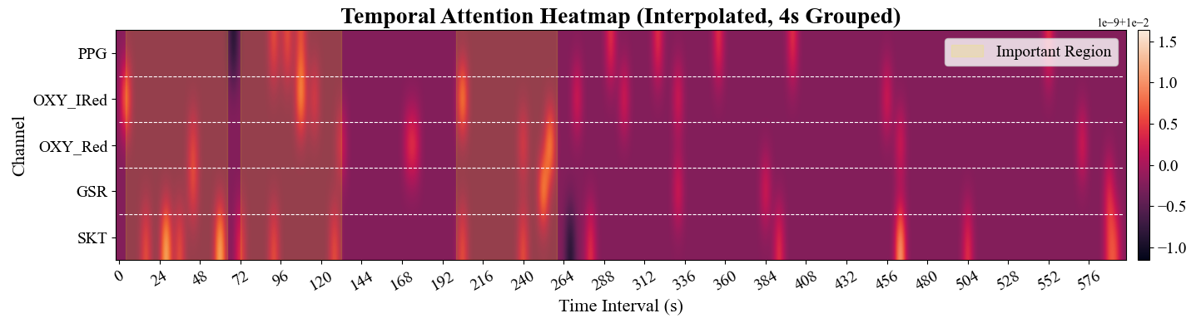
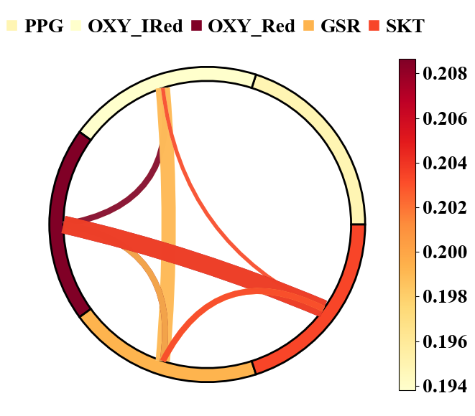
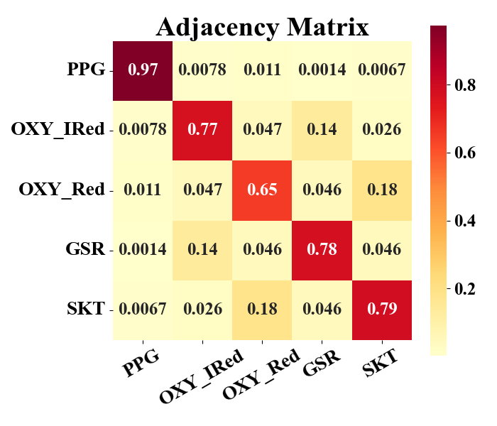












Overview
Overview
Interpretability Analysis
Training Stage:
$$𝓛_{non_ca}$$
$$𝓛_{rr}$$
$$𝓛_{rec}$$
Premise：< signals, label >
Domain
Encoder
E
$$Z_{d}$$
D
E
Class
Encoder
Sub 1
E
$$𝓛_{diff}$$
​​“The user shows potential depression in first 2min and 00:03:20 - 00:04:20."​
Sub 2
Classifier
…
C
$$𝓛_{ca}$$
$$𝓛_{rr}$$
$$𝓛_{cl}$$
E
$$Z_{c}$$
C
Decoder
D
Sub N
Non-causal
Representaition
Testing Stage:
$$Z_{d}$$
E
$$Z_{c}$$
C
“GSR and PPG signals show similar anxiety-detection patterns and are most effective when combined.”
Causal
Representaition
$$Z_{c}$$
Unseen subject
Fig. 1: Overview of G-PsychSW.

Slide 5




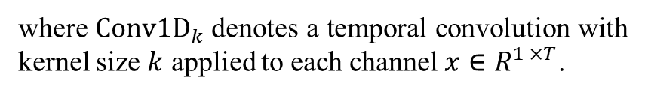



Methodology
(a) Multi-scale Attention Convolution
Multi-scale Attention-based Convolution
Kernel Size = { 3, 5, 7 }
Padding = { 1, 2, 3 }
Attention_Head = 4
Early fusion may obscure their specific patterns and degrade discriminability. To avoid this, we design MAConv in a channel-independent manner.
$$W_{q}$$
$$W_{k}$$
$$W_{v}$$
( 2700, 1 , 100 )
5×1
5×1
5×1
t+1 …
2
t
1
2
(1)
$$Q$$
$$K$$
$$V$$
$$V_{ATT}=MHA\left(Concat\left[Conv1D_{k}\left(x\right)\right]\right), k∈3,5,7$$
… t-1
t+1 …
$$QK^{T}$$
2
3
1
2
1
t
where $Conv1D_{k}$denotes a temporal convolution with kernel size $k$ applied to each channel$x∈R^{1 ×T}$.
… t-1
5×5
Gate-linear
t+1 …
2
1
3
t
LayerNorm
1
4
2
4
( 2700, 96 , 96 )
… t-1
Adaptive AvgPool
( 2700, 1 , 96 )
( 2700, 96 , 100 )
Ch1
… t-1
t+1 …
t
Fig. 1: Overview of G-PsychSW (a).

Slide 6
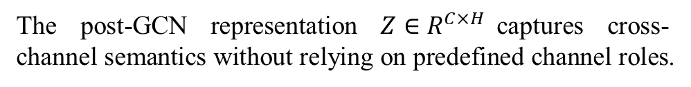
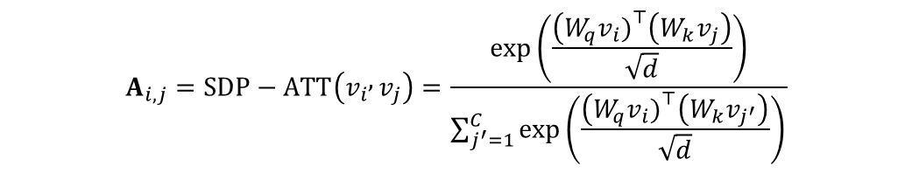
Methodology
(b) Functional Graph Construction
Functional Graph Construction
Biosignals exhibit functional dependencies suitable for graph modeling. FGC module learns inter-channel interactions in a data-driven manner.
…
$$A_{i,j}=SDP−ATT\left(v_{i} , v_{j}\right)=\frac{\exp\left(\frac{\left(W_{q}v_{i}{\left.)\right.}^{⊤}\left(W_{k}v_{j}\right)\right.}{\sqrt{d}}\right)}{\sum_{j^{′}=1}^{C}{\exp\left(\frac{\left(W_{q}v_{i}{\left.)\right.}^{⊤}\left(W_{k}v_{j^{′}}\right)\right.}{\sqrt{d}}\right)} }$$
Channels
PPG
OXY_Red
OXY_Ired
GSR
SKT
(2)
The post-GCN representation $Z∈R^{C×H}$captures cross-channel semantics without relying on predefined channel roles.
… t-1
t
t +1 …
Fig. 1: Overview of G-PsychSW (b).

Slide 7
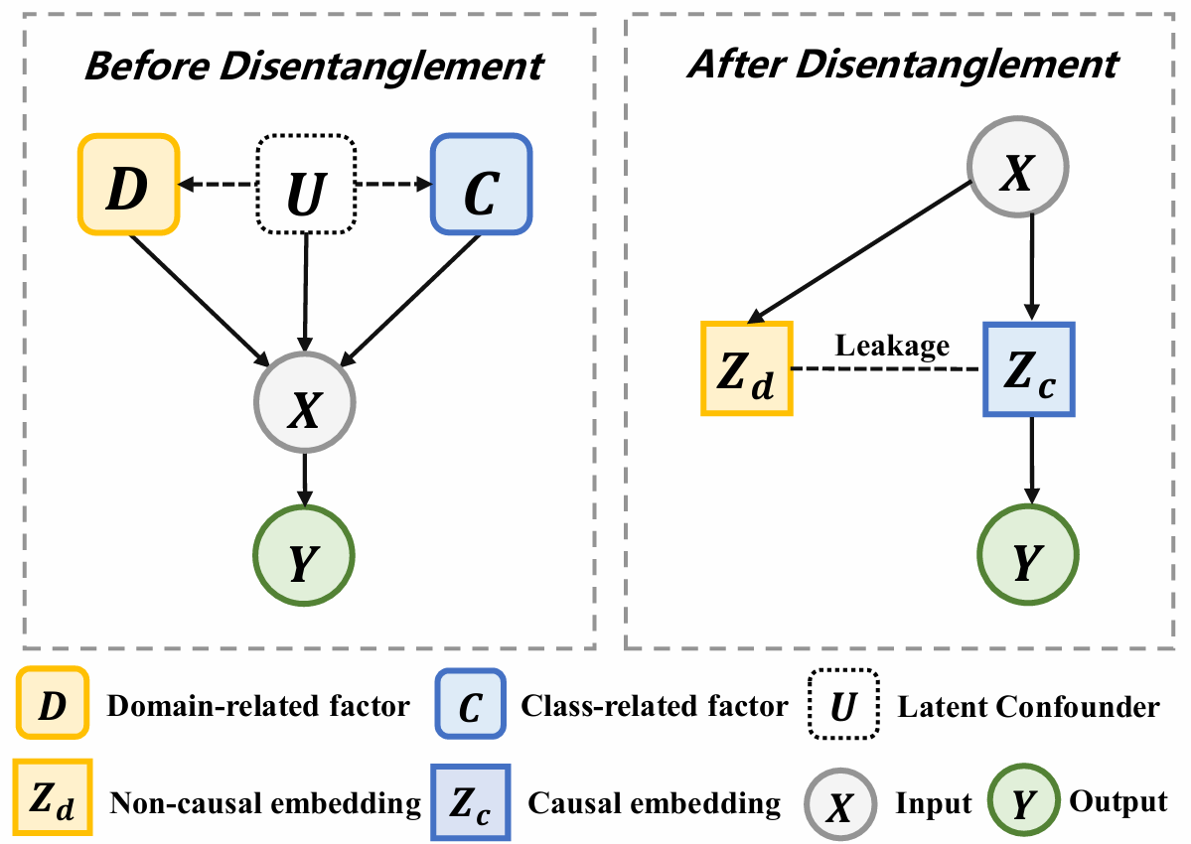
Methodology

Slide 8
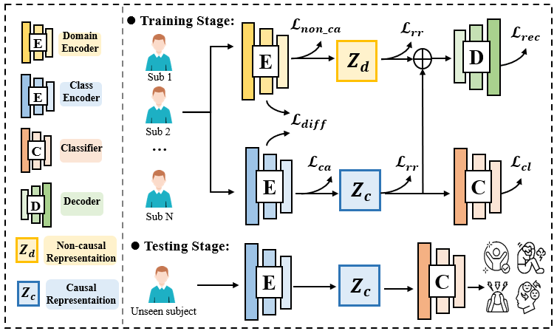
Methodology
Causal Disentanglement
Fig. 1: Overview of G-PsychSW.

Slide 9
Methodology
Causal Disentanglement
Fig. 1: Overview of G-PsychSW.

Slide 10
Methodology
Causal Disentanglement
Fig. 1: Overview of G-PsychSW.

Slide 11
Methodology
Causal Disentanglement
Fig. 1: Overview of G-PsychSW.

Slide 12
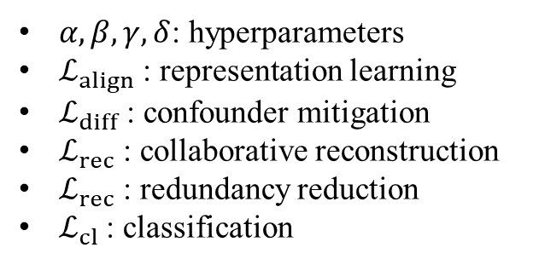
Methodology
Causal Disentanglement
The overall objective combines all losses to learn disentangled and generalizable representations:
$$ℒ_{total}=αℒ_{align}+βℒ_{diff}+γℒ_{rec}+δℒ_{rr}+ℒ_{cl}$$
(3)
$α, β,γ,δ$: hyperparameters
$ℒ_{align}$: representation learning
$ℒ_{diff}$ : confounder mitigation
$ℒ_{rec}$: collaborative reconstruction
$ℒ_{rec}$: redundancy reduction
$ℒ_{cl}$: classification
Fig. 1: Overview of G-PsychSW.

Slide 13
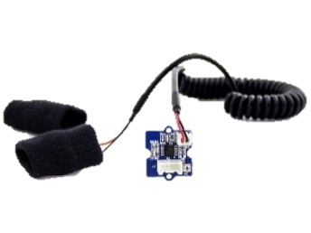
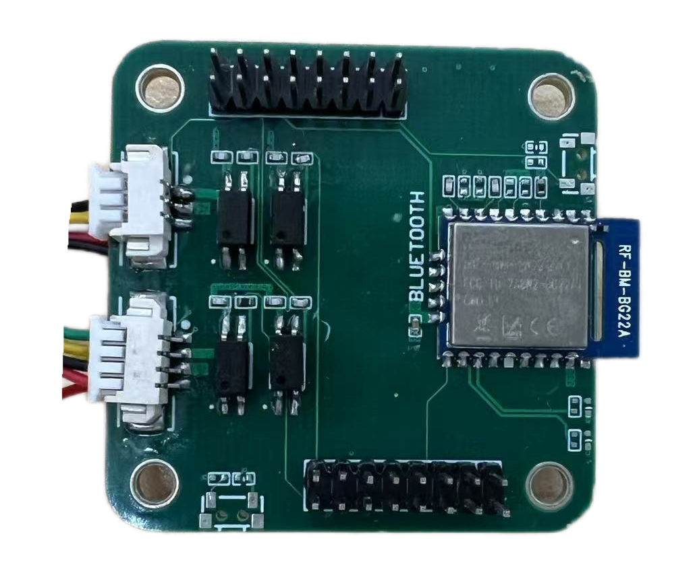
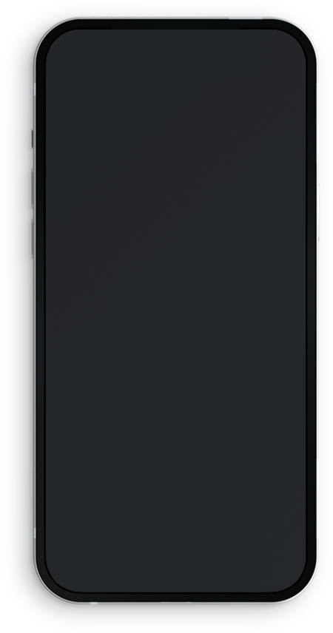
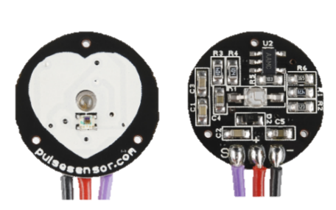
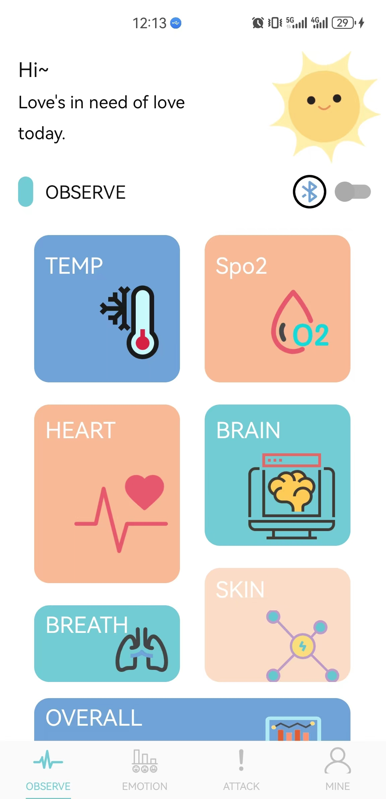
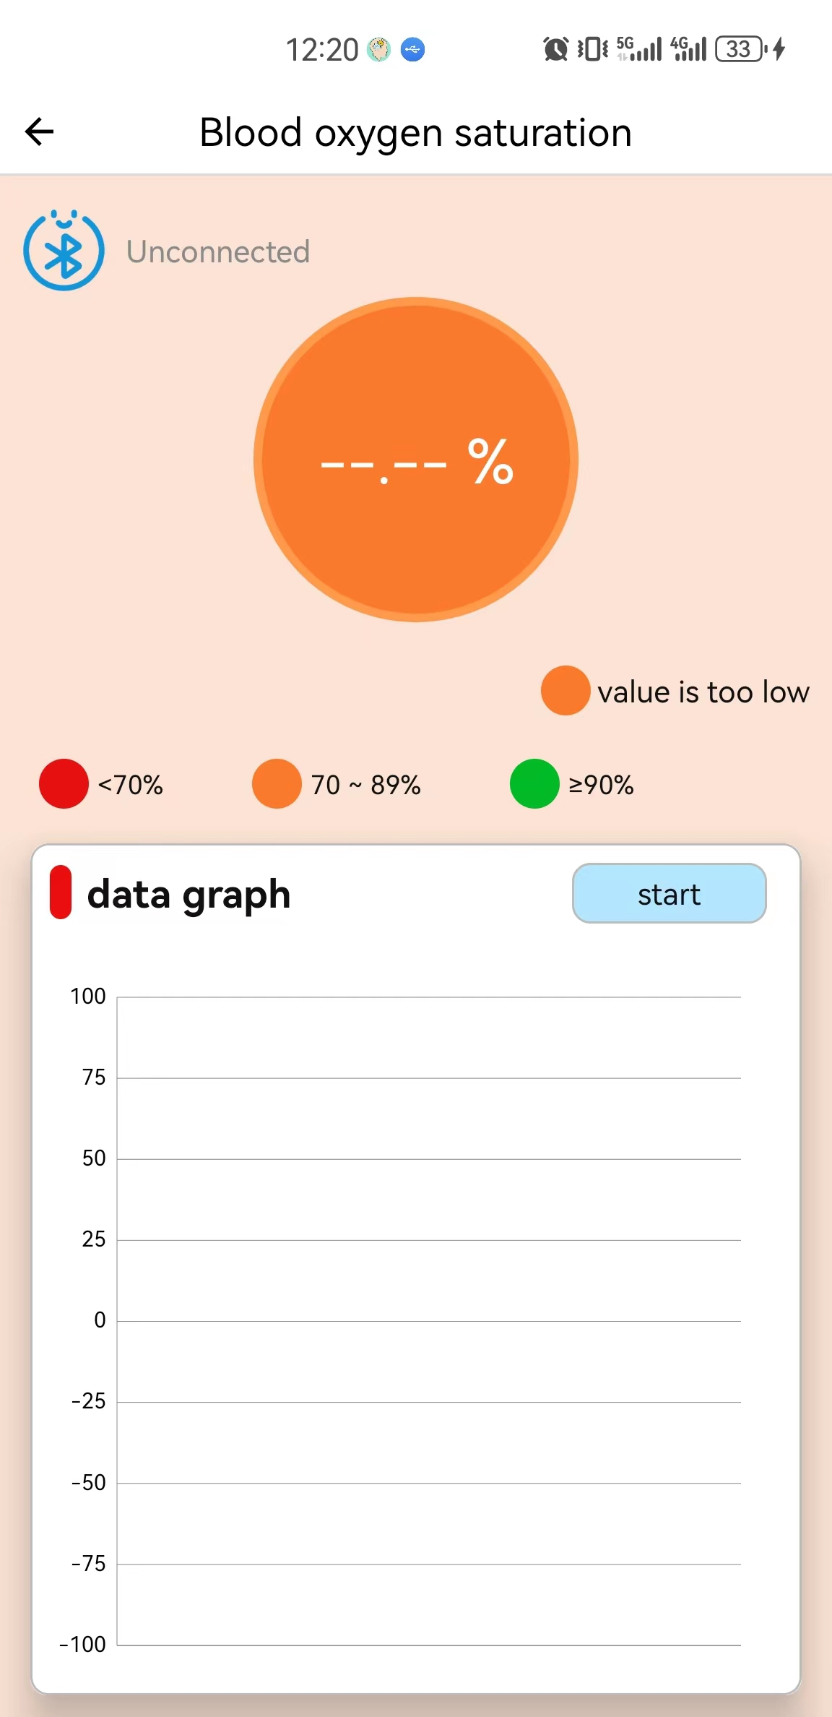
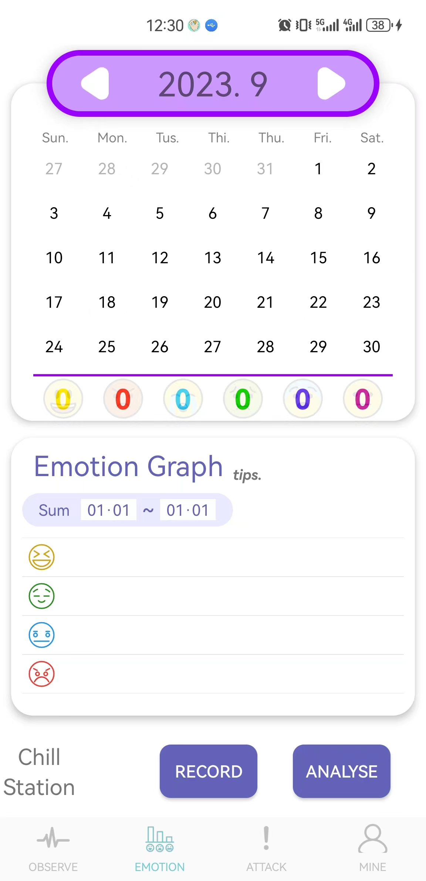
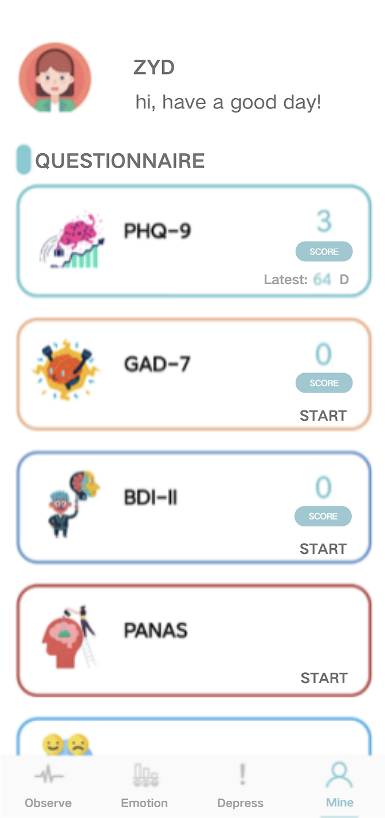
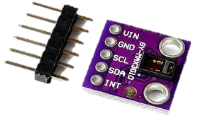
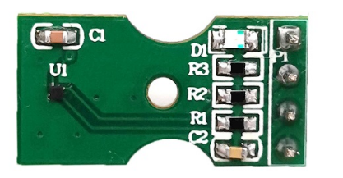
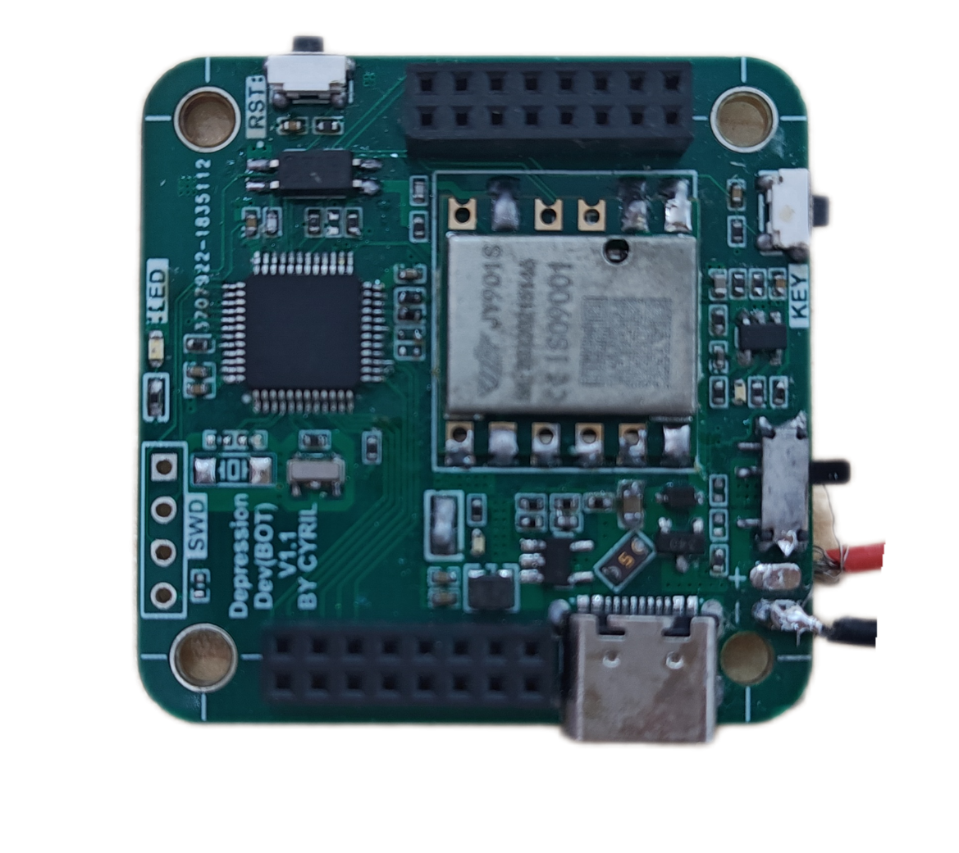
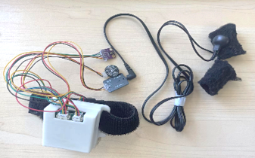
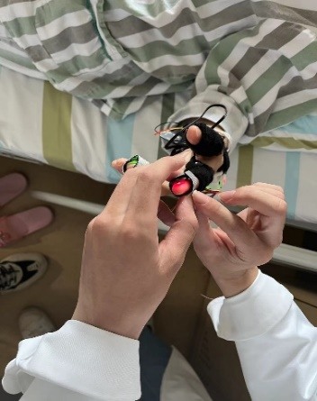
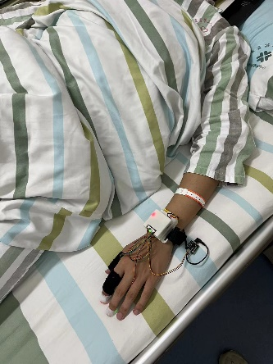
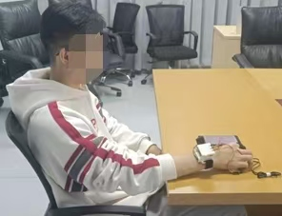
Experiment
Hardware
Pulse sensor
Max30102
GSR sensor
LMT70
STM32 as the microcontroller
RF-Star as Bluetooth module
Size: 2 × 45 × 30 mm
Weight: 111.8 g
Dataset
74 participants (40males, 34 females), aged 14–60
18 with depression, 22 with anxiety, and 16 with bipolar disorder, 18 healthy controls
noise levels ranging from 40 dB to 55 dB
Lasts for 45min for each participant
Pulse Sensor
Grove GSR
GPIO
BLE
Max30102
LMT70
(b) Software Interface
Grove GSR
Physiological Sensors
MCU
BAT+/-
Self-designed PCB
(a) Hardware Prototype
(c) Experiment Step
Fig 2: The system prototype and experiment setup.

Slide 14
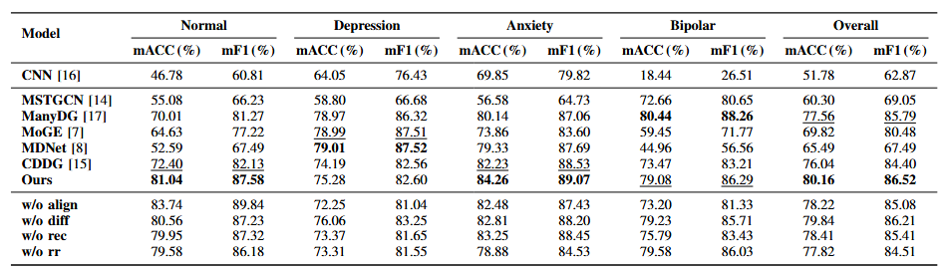
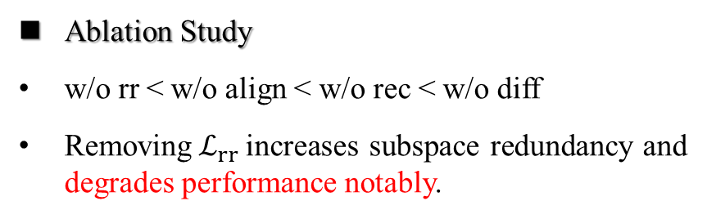
Result
TABLE I: Performance on Subject-Independent Psychiatric Screening: Baselines vs. Ablated Variants
Cross-subject Performance
80.16% ACC, 86.52% F1 for Our method
Our methods outperforms existing cross-domain baselines
Ablation Study
w/o rr < w/o align < w/o rec < w/o diff
Removing${ ℒ}_{rr }$increases subspace redundancy and degrades performance notably.

Slide 15
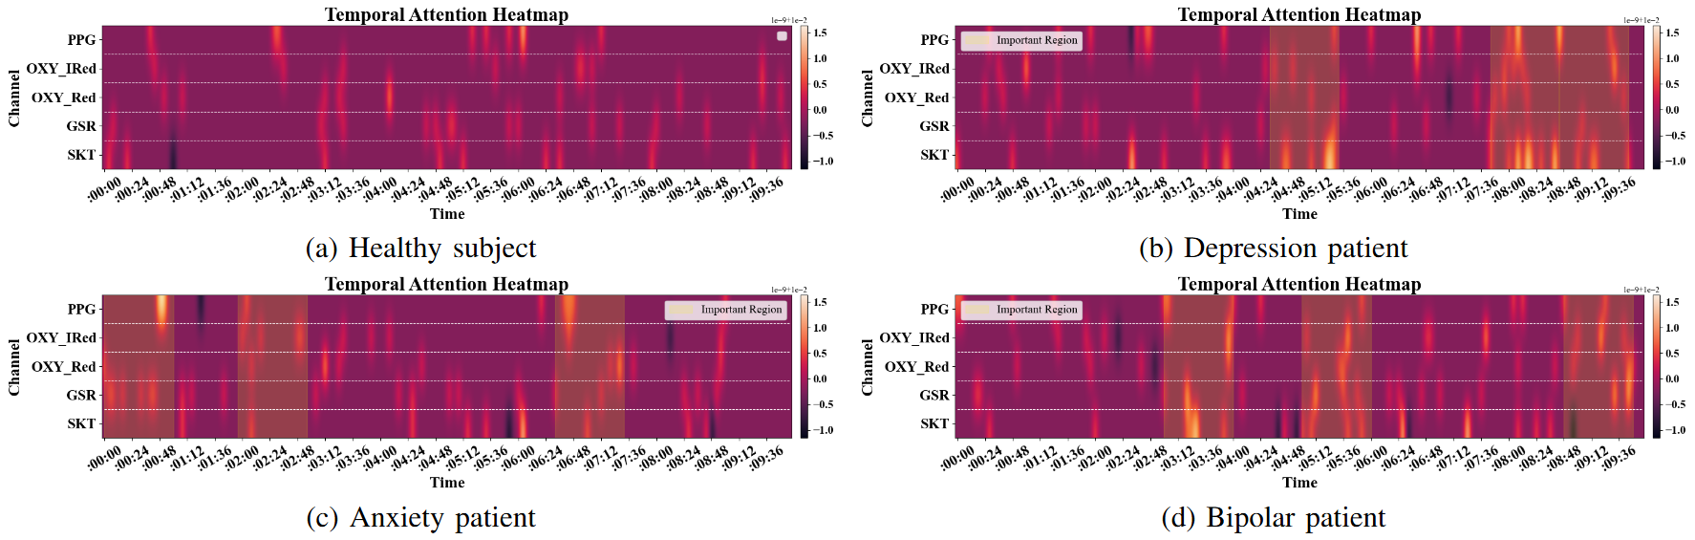
Result
Fig. 3: Temporal Attention Heatmap Across Subjects.
Interpretable Patterns of Temporal Attention
Warm colors → high importance; Cool colors → low relevance; Top-3 segments highlighted in yellow.
Tracking high-importance segments helps identify symptom episodes and supports early intervention.

Slide 16
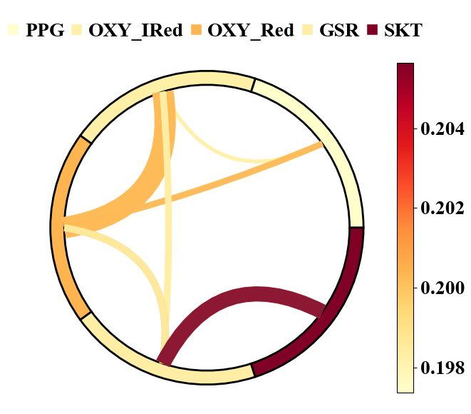
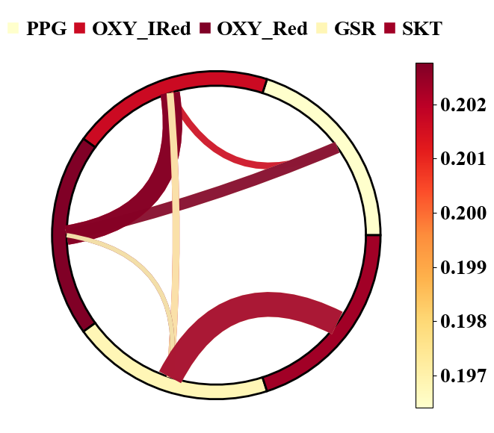
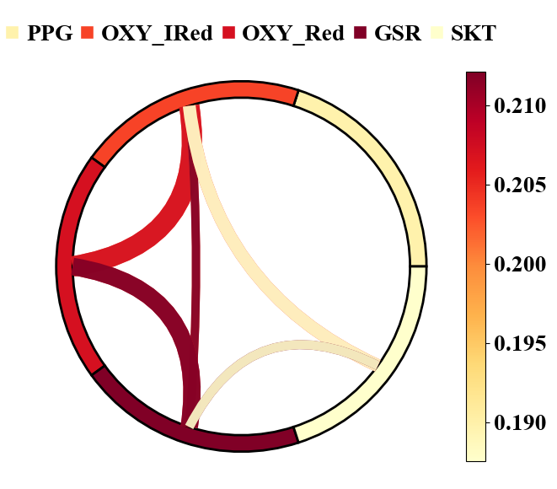
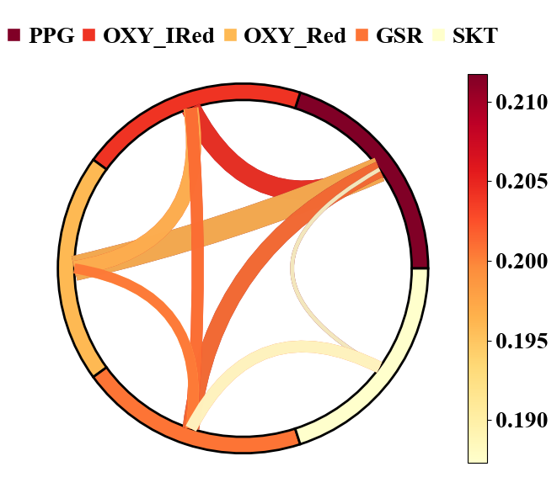
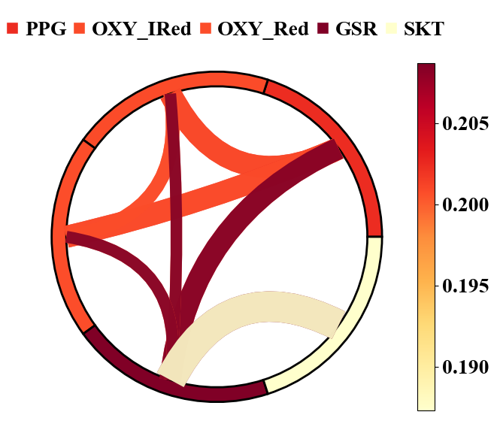
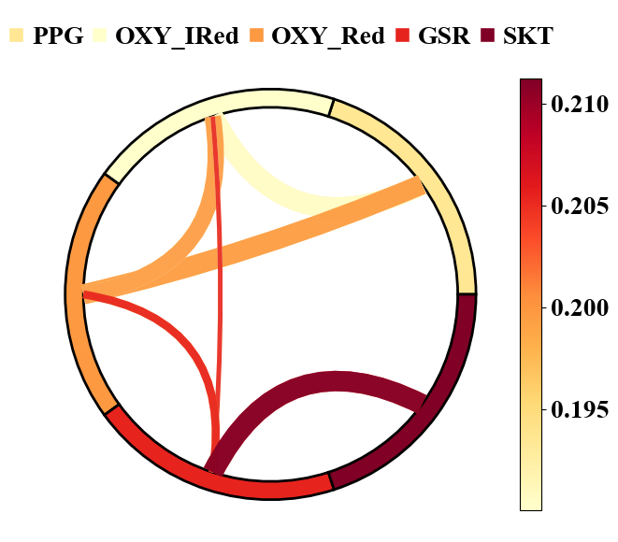
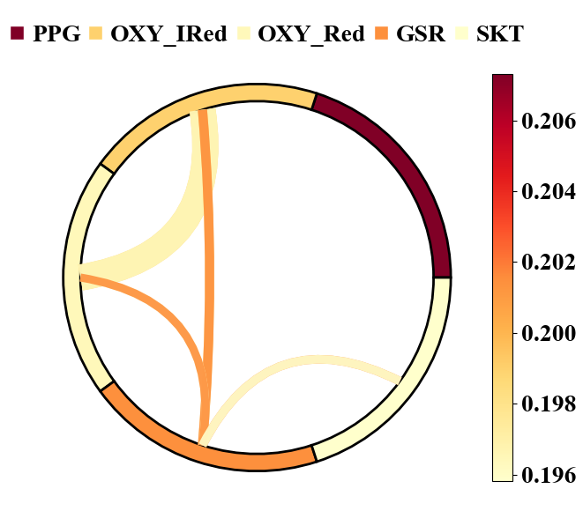
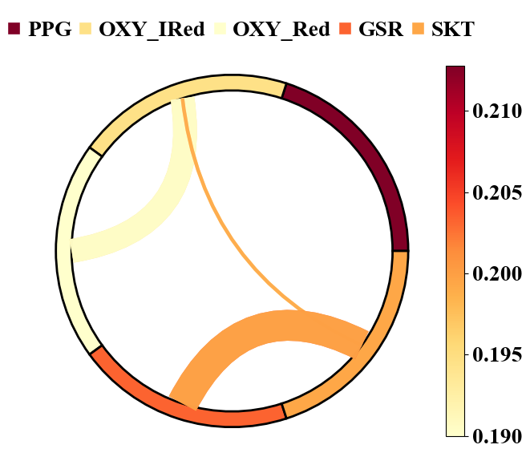
Result
(a) Group A - sub1 (b) Group A - sub2 (c) Group A - sub3
(g) Group C - sub1 (h) Group C - sub2 (i) Group C - sub3
Interpretable Patterns of Channel Connection
Color intensity → importance in decision process
Chord thickness → inter-channel dependency strength
Visualizing inter-channel connections helps reveal signal interactions and provide stronger support for psychiatric screening
(d) Group B - sub1 (e) Group B - sub2 (f) Group B - sub3
Fig. 4: Channel Importance and Inter-Channel Connection Across Patient Groups. Group A: Depressive Disorder; GroupB: Anxiety Disorder; Group C: Bipolar Disorder.

Slide 17
Conclusion
Generalizable and interpretable mobile system designed for psychiatric screening with physiological insights.
Causal disentanglement with multi-loss optimization isolates class factor from individual variability, enhancing robustness to domain shifts.
Integrated dual-attention mechanism which captures temporal dynamics and functional connectivity, to adaptively identify when, which, and how biosignals drive predictions.

Slide 18
Thanks
Q&A

