Slide 1


深圳大学计算机与软件学院
College of Computer Science and Software Engineering, SZU
CoMe: Contrastive Learning-based Mental Disorder
Recognition with Wearable Multimodal Physiological Data
Yulan Li∗, Shuo Jin∗, Kaishun Wu†, Changhe Fan‡, Yongpan Zou∗
∗College of Computer Science and Software Engineering, Shenzhen University
†Information Hub, Hong Kong University of Science and Technology (Guangzhou)
‡Department of Psychiatry, Affiliated Guangdong Second Provincial General Hospital of Jinan University

Slide 2
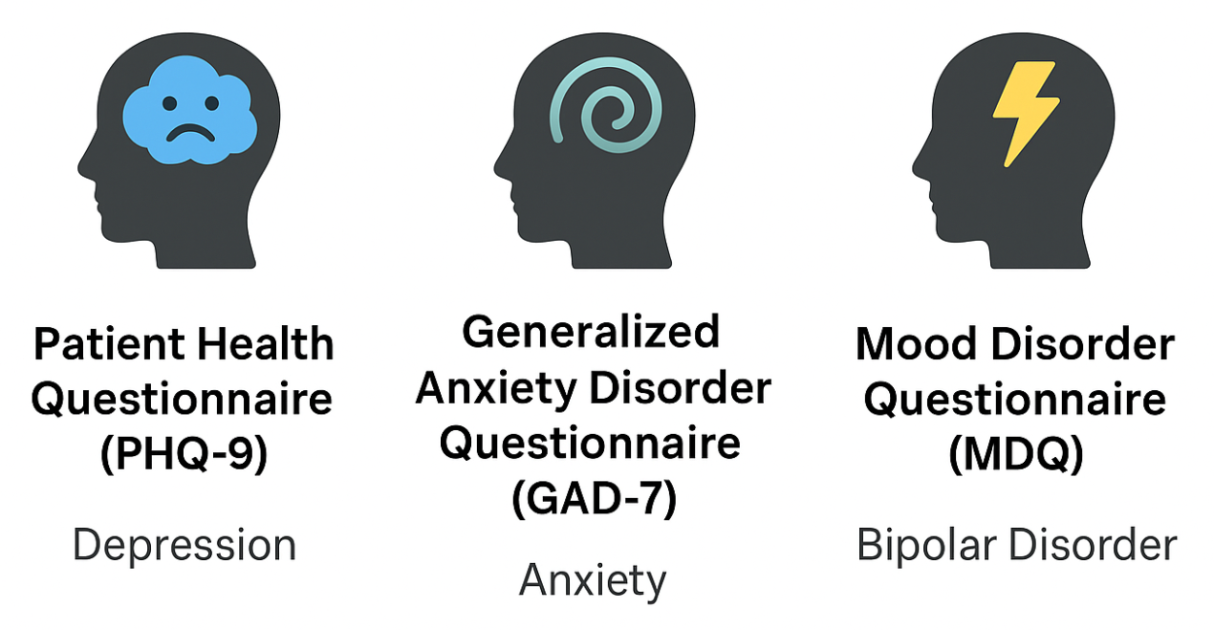
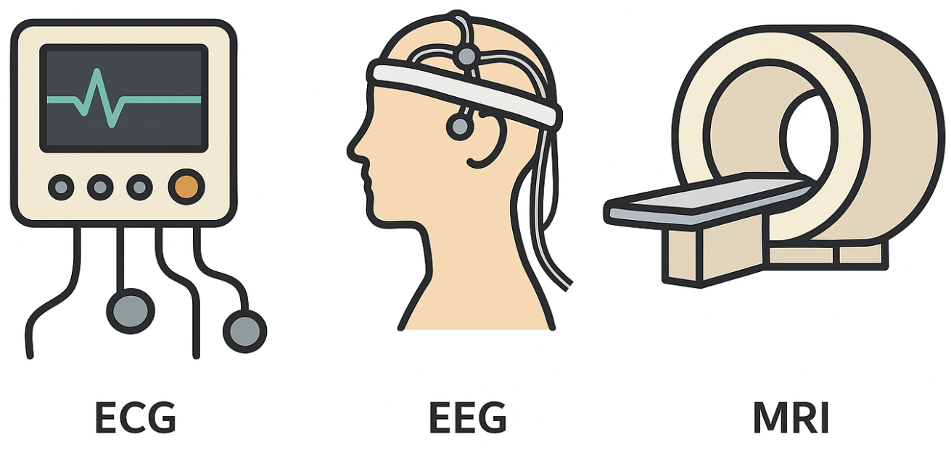

Background
Traditional questionnaires
Specialized medical equipment
Wearable devices
Subjective
Intermittent
Single-disorder screening
Expensive
Intermittent
Nonportable
Cheap
Continuous
Portable
Need: A practical system for daily multi-class mental disorder monitoring

Slide 3
Sum up
Challenge
The scarcity of high-quality labeled data
Large individual differences in physiological signals
Symptom overlap among disorders
Contribution
We propose CoMe, the first multi-class mental disorder monitoring system via low-cost wearables, capturing multimodal signals for daily identification of depression, anxiety, bipolar disorder.
We construct a multimodal physiological dataset encompassing these mental conditions and healthy controls.
We design a two-stage contrastive framework with multimodal residual deformable convolution network fusion to extract common and specific patterns from unlabeled data, and enable rapid user personalization.

Slide 4
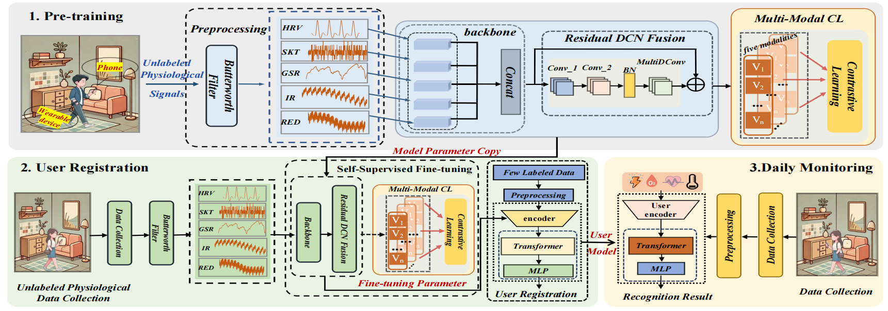
System Overview
Fig 1. CoMe overview.
Stage 1: Pre-training with large-scale unlabeled data
Stage 2: Personalized fine-tuning with a few minutes of user data
Customized model supports daily monitoring

Slide 5
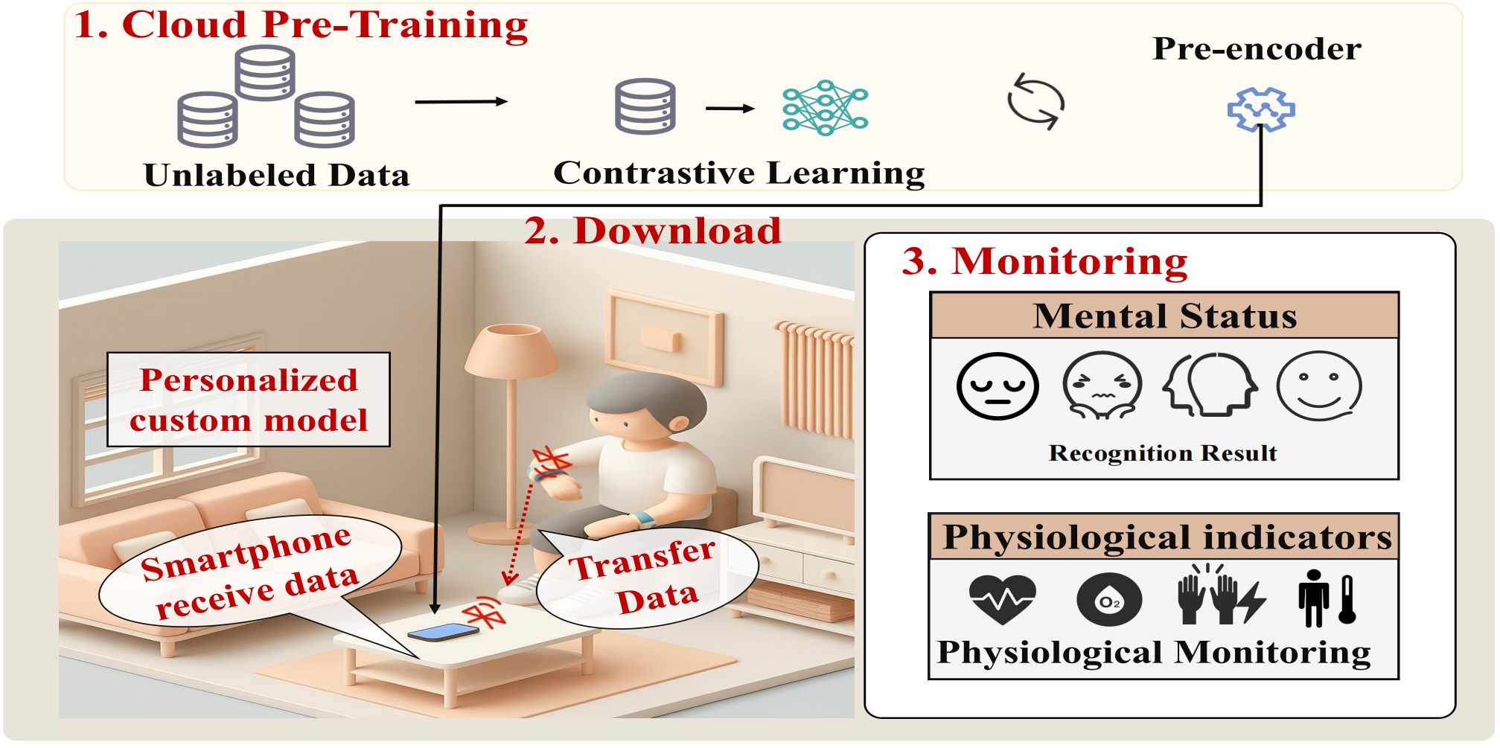
System Overview
Typical application scenarios of CoMe
Fig 2. A typical application scenario of CoMe.

Slide 6
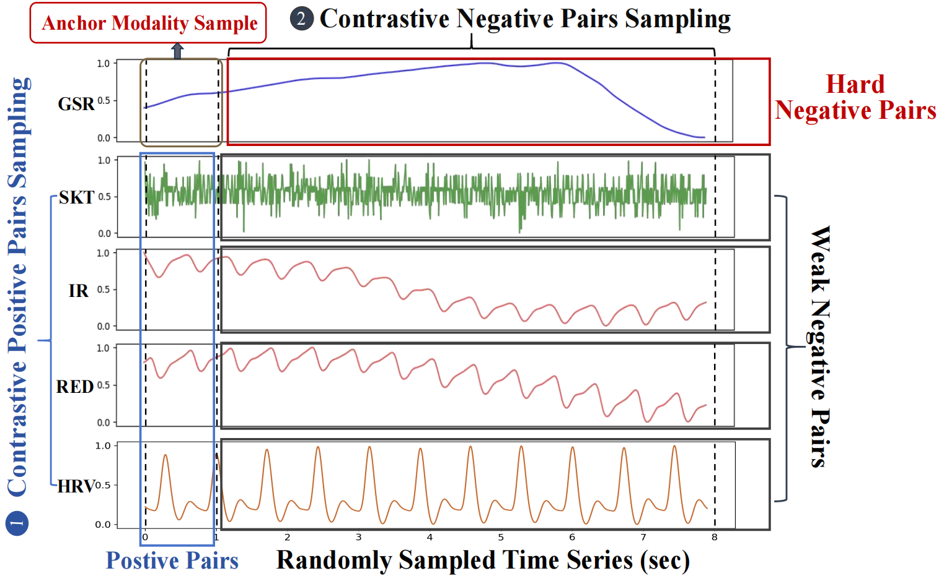
System design-Pre-training
Multi-modal Contrastive Learning
sampling principle: CoMe combines both coarse-grained and fine-grained pairing, helping learning such modality-aware representations from unlabeled data.
  Positive pairs : data from other modalities at the same time point
  Hard negatives : samples from the same modality at different times
  Weak negatives : samples from other modalities at different times form
Learning Objective: Maximize the alignment of positive pairs and push apart negative samples
Fig 3. Sampling principle.

Slide 7
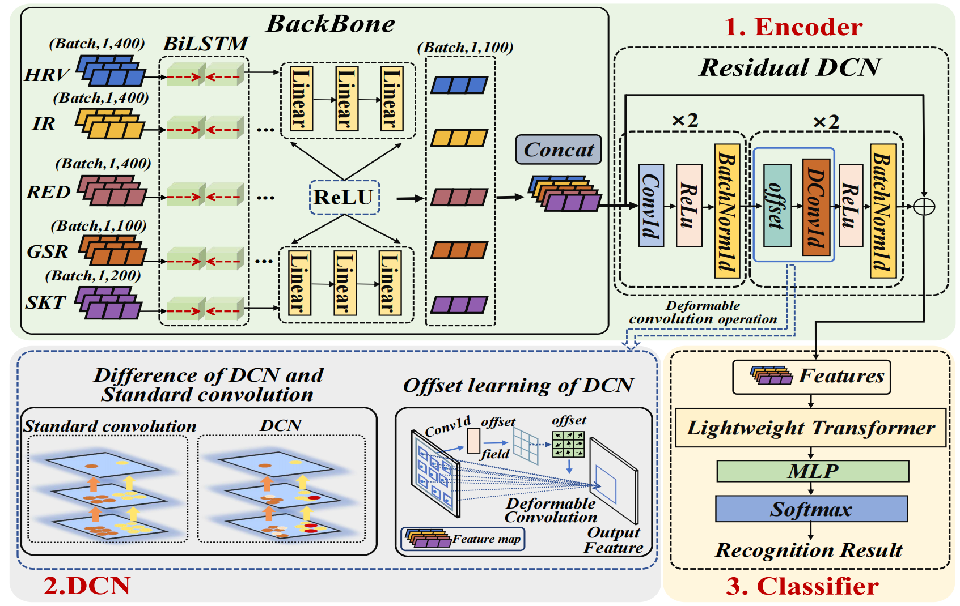
System design-Pre-training
Multi-modal Fusion: CoMe employs a residual DCN fusion scheme.
Fig 4. Illustration of residual DCN fusion.

Slide 8
System design-Personalized Customization
Fig 1. CoMe overview.
Personalized Customization Phase
New users provide only a few minutes of unlabeled target data → self-supervised fine-tuning of pre-encoder
Use a small labeled subset to train a lightweight classifier → daily mental health monitoring

Slide 9
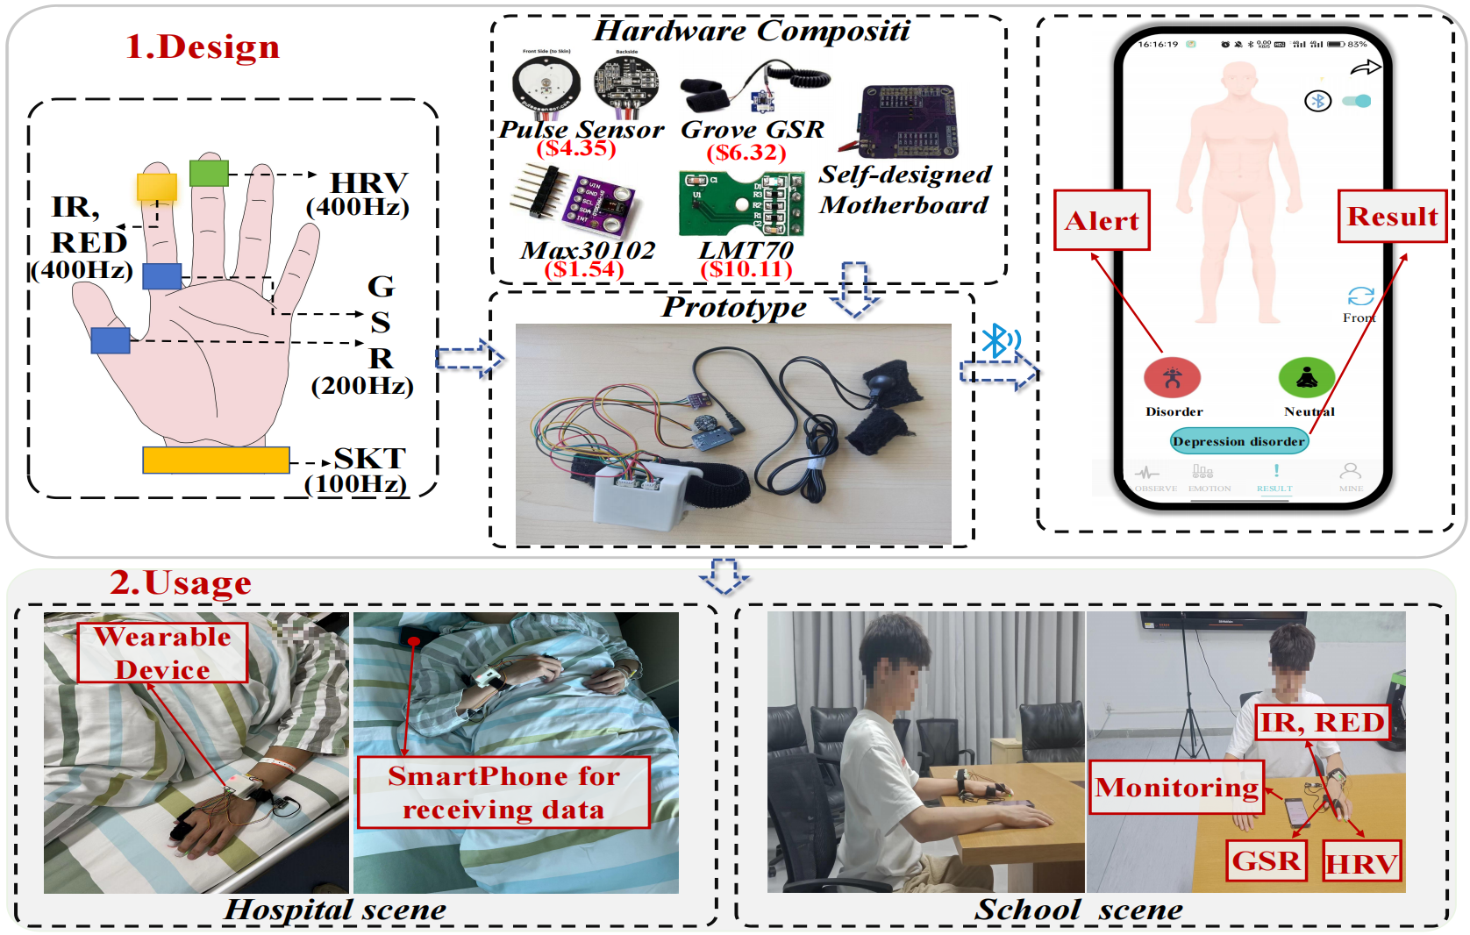
Implementation and Experiment
Custom wearable device
  total cost: $25.13
  HRV, IR, RED, GSR, SKT
Software Deployment
Multimodal physiological dataset
  74 participants(40 male / 34 female; age 14–60)
  18 depression, 22 anxiety, 16 bipolar, 18 healthy
  Recording: 10 days × 30 min/day for each participant
Metrics
  Accuracy
  Detection rate
  Misdiagnosis rate
Fig 5. Design and usage for CoMe.

Slide 10
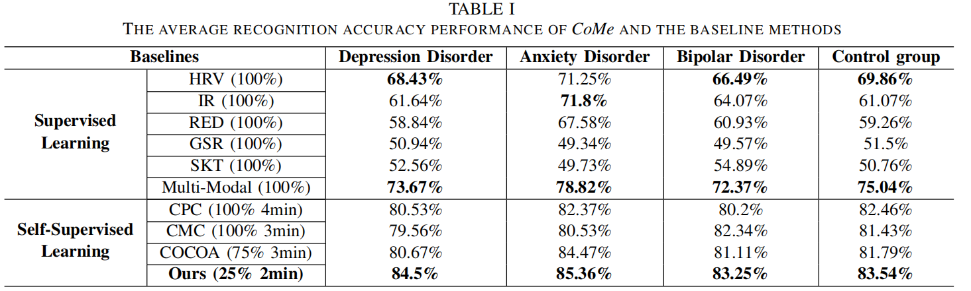
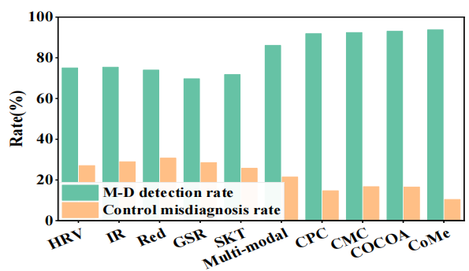
Results-Main Results
Performance of Accuracy
84.5% for depression disorders
85.36% for anxiety disorders
83.25% for bipolar disorders disorders
83.54% for control group disorders
Performance of mental disorder (M-D) group detection rate: 93.76%
Performance of control group misdiagnosis rate: 10.41%
Fig 6. Comparison of detection and misdiagnosis rates.

Slide 11
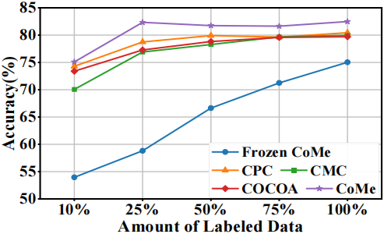
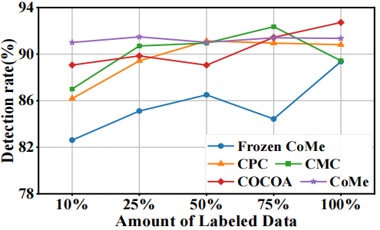
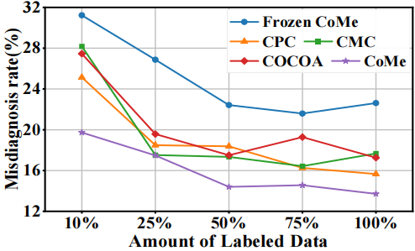
Results
Fig 7. Accuracy across labeled data amounts.
Fig 8. Detection rate across labeled data amounts..
Optimal amounts of labeled data for best performance:
CPC 100%
CMC 100%
COCOA 75%
CoMe 25%
Fig 9. Misdiagnosis rate across labeled data amounts.

Slide 12
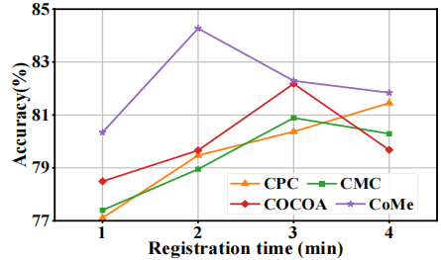
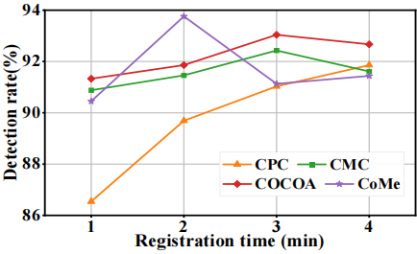
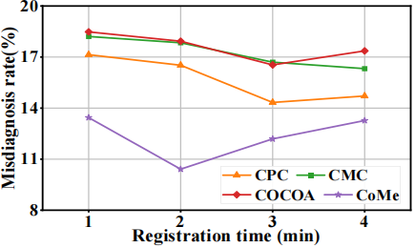
Results
Fig 10. Accuracy over registration Time.
Fig 11. Detection rate over registration Time.
Optimal registration time for best performance:
CPC 4min
CMC 3min
COCOA 3min
CoMe 2min
Fig 12. Misdiagnosis rate over registration Time.

Slide 13
Conclusion
Design a wearable-based system for daily multi-class monitoring of Depression, Anxiety, and Bipolar disorders.
Propose a two-stage self-supervised contrastive framework, addressing the issue of scarce labeled physiological data.
Demonstrate superior generalization and rapid personalization capabilities, validating potential for continuous early risk detection.

Slide 14






Q&A
Thanks!

